Slide 1

HIPEC Does Not Play A Role in the Treatment of Advanced Ovarian Cancer
Philipp Harter, MD
Kliniken Essen-Mitte
Essen, Germany

Slide 2
Definition of (Becoming) a New Standard Of Care
Showing superiority regarding OS/PFS within a prospective randomized trial
Less toxicity…
Better quality of life…
Cost reduction…

Slide 3
Cost Reduction
Cost reduction itself unlikely
Additional rate of HIPEC ~4500€
Higher rate of complications
…no cost reduction in the first weeks
But maybe cost effective in case of prolonging survival?
HIPEC, hyperthermic intraperitoneal chemotherapy

Slide 4
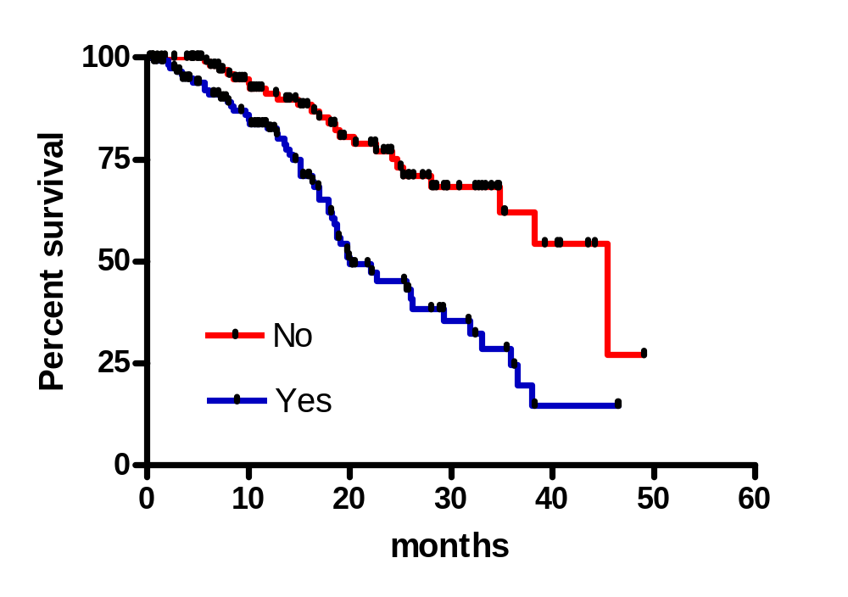
Does Peritoneal Carcinomatosis Need A Special Treatment?
Is peritoneal carcinomatosis a prognostic factor ?
Median OS: PC No: 45.4 months
Yes: 20.0 months
P<.0001; HR: 0.37 (95% CI: 0.24 – 0.59)
Or “only” a negative predictor for complete resection?
The rate of complete resection was 74% in pts without peritoneal carcinomatosis
and 26% in pts with carcinomatosis in DESKTOP I
Harter P, et al. Ann Surg Oncol. 2009;16(5):1324-1330.

Slide 5
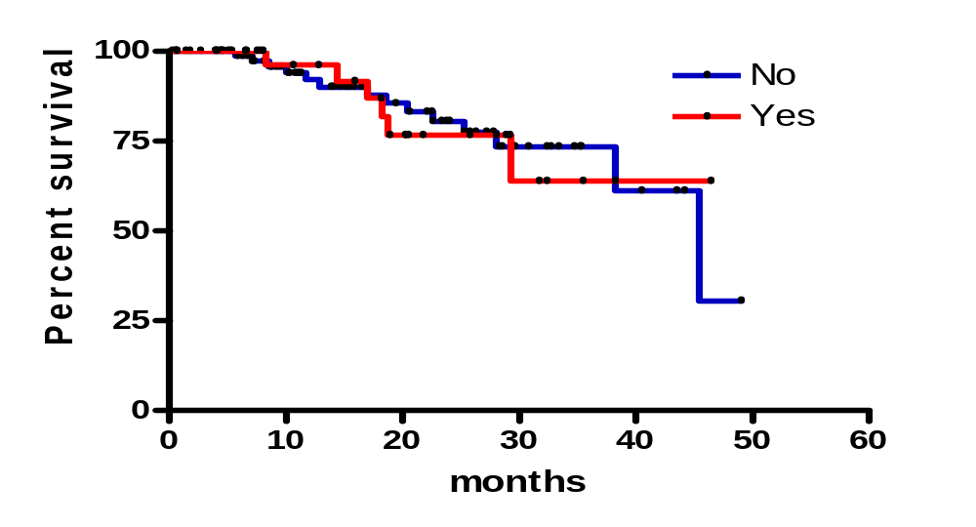
Does Peritoneal Carcinomatosis Need A Special Treatment?
TuR=0 with PC and non-PC
P = .96, HR: 0.98 (95%CI: 0.37 – 2.6)
No difference in survival if complete resection was achieved, irrespective of intraoperative findings regarding peritoneal carcinomatosis
Peritoneal carcinomatosis is not a prognostic factor, “only” a negative predictor for a successful surgery
PC, peritoneal carcinomatosis
Harter P, et al. Ann Surg Oncol. 2009;16(5):1324-1330.

Slide 6
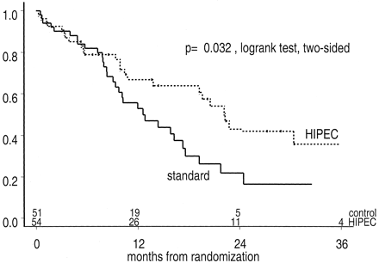
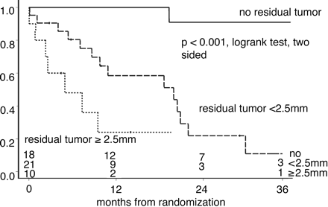
Randomized Study Surgery + HIPEC -> IV Versus IV-Therapy in Recurrent Colorectal Cancer (n = 105)
Cytoreduktive OP + HIPEC vs IV
Prognostic Factor Residual Disease
- Cytoreductive surgery + HIPEC -> IV better than IV/palliative management only
- Residual disease strongest prognostic factor (results caused by surgery, HIPEC, or both?)
- Morbidity: 54 % G3/4 toxicity (15% fistula); mortality: 8%
- 1-year survival by IV only: 48%; 1-year survival HIPEC with residual tumor: 35% (if >2.5 mm only 20%)
- If complete resection is not possible, definitely no benefit from surgery + HIPEC
- Adverse effects from HIPEC?!
Verwaal VJ, et al. J Clin Oncol. 2003;21(20): 3737-3743.

Slide 7
Primary Surgery Gastric Cancer
Gastrectomy + LNE
Gastric Ca
T2-T4
n = 139
Gastrectomy + LNE
+ HIPEC
Gastrectomy + LNE
+IPEC
5-year survival: 42% (gastrectomy + LNE), 43% (+ IPEC), and 61% (+ HIPEC)
-> Only in an (unplanned?) subgroup analysis (Serosa+ and N+) was a statistically significant improvement found for HIPEC
Yonemura Y, et al. Hepatogastroenterology. 2001;48(42):1776-1782.

Slide 8
Randomised Trial Surgery + HIPEC vs Surgery in Gastric Cancer With Peritoneal Metastases (n = 68)
Single-center trial
Includes primary and relapsed disesase
Complete resection rate 58% in both arms
Primary endpoint: Disease-specific survival
Yang XJ, et al. Ann Surg Oncol. 2011;18(6):1575-1581.

Slide 9
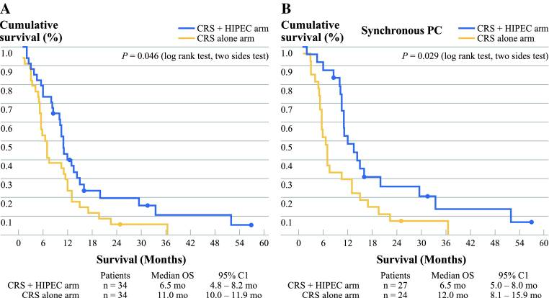
Randomised Trial Surgery + HIPEC vs Surgery in Gastric Cancer With Peritoneal Metastases (n = 68)
HIPEC improved DSS from 6.5 to 11 months in all pts and to 12 months in
the subgroup of patients with synchronous peritoneal carcinomatosis
Yang XJ, et al. Ann Surg Oncol. 2011;18(6):1575-1581.

Slide 10
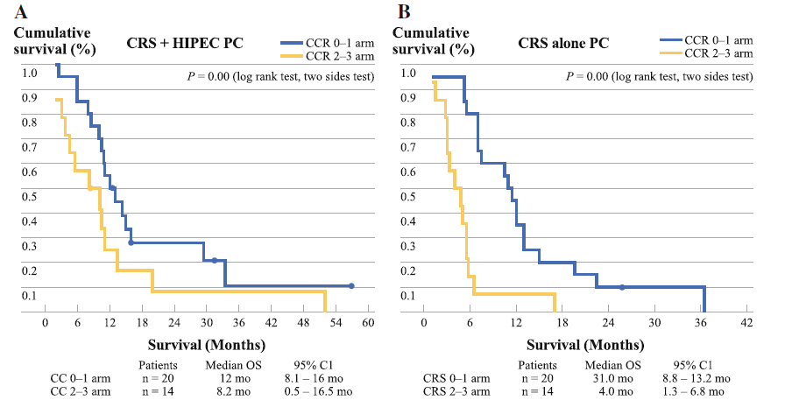
Randomised Trial Surgery + HIPEC vs Surgery in Gastric Cancer With Peritoneal Metastases (n = 68)
Patients with complete resection without HIPEC had best prognosis
(Disesase-specific survival 31 months)
Yang XJ, et al. Ann Surg Oncol. 2011;18(6):1575-1581.

Slide 11
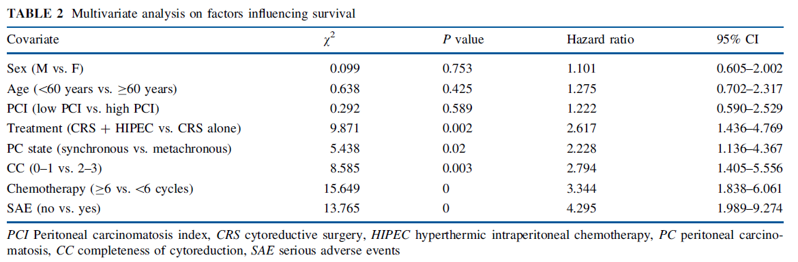
Randomised Trial Surgery + HIPEC vs Surgery in Gastric Cancer With Peritoneal Metastases (n = 68)
Most important prognostic factors:
Postoperative complications and systemic chemotherapy!
Yang XJ, et al. Ann Surg Oncol. 2011;18(6):1575-1581.

Slide 12
Randomised Trial Surgery + HIPEC vs Surgery in Gastric Cancer With Peritoneal Metastases (n = 68)
Additional findings and remarks:
  NCT00454519: this was another trial
  Subgroup synchronous PC: Ad hoc analysis
    Opposite result in metachronous subgroup
  Why was the primary endpoint during (after?) the study changed to disease-specific survival?
  (= exclusion of postoperative fatal events!)
  No data for OS
  Systemic therapy after surgery not standardized

Slide 13
Is HIPEC a Promising New Treatment Option in Ovarian Cancer?
Limited evidence in colorectal and gastric cancer!
- except additional budget
Any evidence in ovarian cancer?

Slide 14
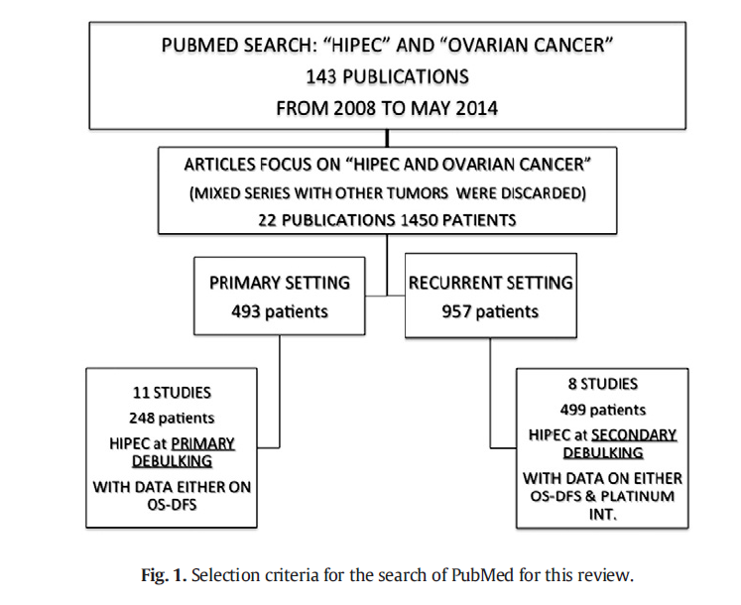
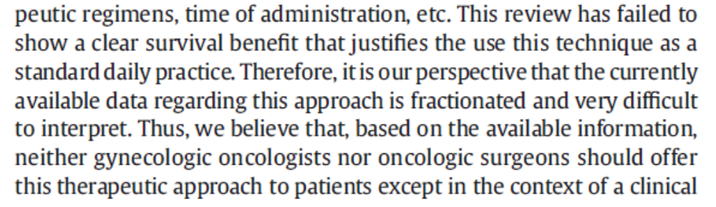
Systematic Review HIPEC in Ovarian Cancer
Chiva LM, et al. Gynecol Oncol. 2015;136(1):130-135.

Slide 15
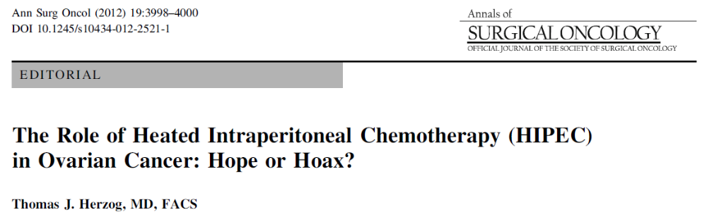
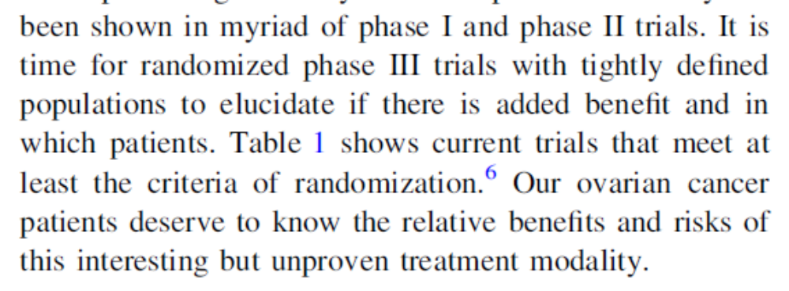
Herzog TJ. Ann Surg Oncol. 2012;19(1):3998-4000.

Slide 16
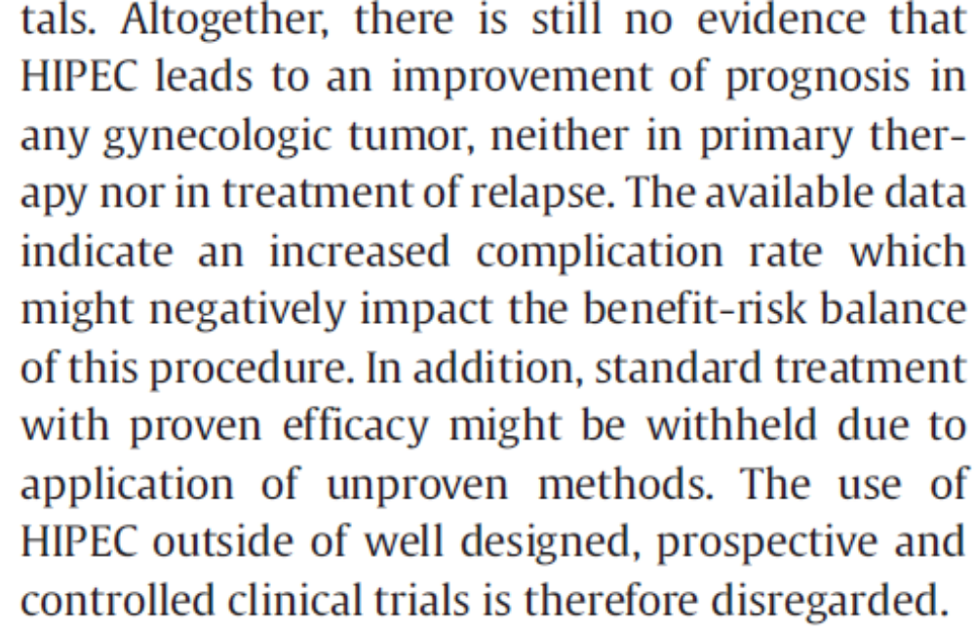
Statement by the Kommission OVAR on the Use of HIPEC to Treat Primary and Recurrent and Recurrent Ovarian Cancer
Harter P, et al. Geburtshilfe Frauenheilkd. 2013;73(3): 221-223.

Slide 17
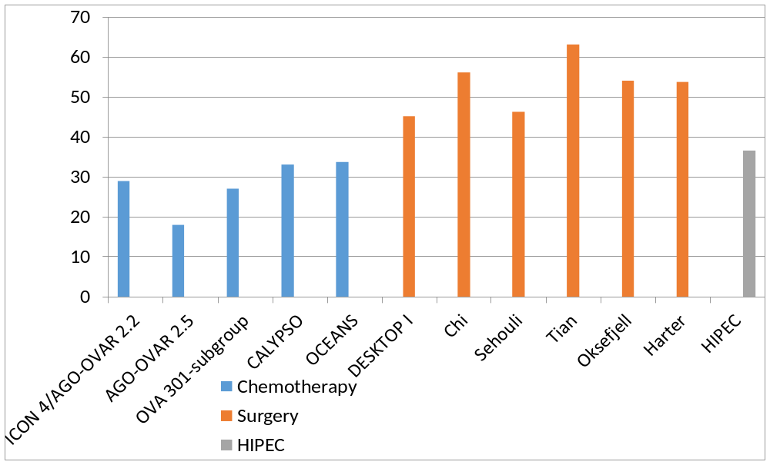
Randomized Chemotherapy Phase III Trials, Surgical Series (Platinum Sensitive) OS of Superior Arm/OS in Optimal Debulking
[Chiva LM, et al. Gynecol Oncol. 2015;136(1):130-135.]

Slide 18
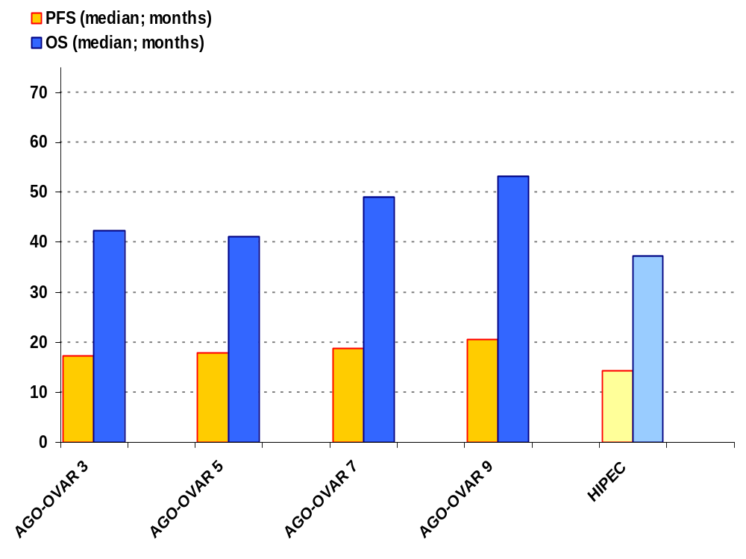
after primary debulking surgery compared to HIPEC series
AGO-OVAR 3
779 pts
60% Tu< 10 mm
AGO-OVAR 5
1.253 pts
67% Tu< 10 mm
AGO-OVAR 7
1.289 pts
65% Tu< 10 mm
AGO-OVAR 9
1.585 pts
71% Tu< 10 mm
Review HIPEC
248 pts
88% Tu< 2.5 mm
Chiva LM, et al. Gynecol Oncol. 2015;136(1):130-135.

Slide 19

N = 120 patients with relapsed stage IIIC or IV disease
Primary endpoint: Mean OS – at least unusual
Inclusion criteria:
  GOG performance status 0 or 1
  not more than three sites of bowel obstruction
  no evidence of disease beyond the abdomen
  no splanchnic metastasis
  no bulky disease in retroperitoneal area or on the mesentery
Spiliotis J, et al. Ann Surg Oncol. 2014 Nov 13 [Epub ahead of print].

Slide 20
Image not available

Slide 21
Randomized Trial Surgery + HIPEC vs Surgery in Ovarian Cancer (n = 120)
Additional findings and remarks:
  In manuscript not mentioned if this study was registered (and I could not find it in any database)
  Report about statistics at a very low level
  Who has reviewed this paper before publication?
This trial does not add any meaningful evidence for our daily work

Slide 22





Conclusions
Standard of care in treatment of patients with recurrent ovarian cancer is systemic treatment
Additional cytoreductive surgery might be an option in selected patients (DESKTOP III, GOG 213)
immediately wasting resources with low quality trials
  performing HIPEC outside of randomized controlled trials!
planning another HIPEC trial (> 6 are already ongoing)!
consider interrupt ing your ongoing HIPEC trial for an interim analysis!

